Slide 1




Challenges in regulating dark patterns effectively
Nataliia Bielova
Cristiana Santos
Towards a neuro-ethical law
23rd May 2024
Notes:
https://notes.inria.fr/6uN3Lpo7R0uxxE7C8T7r8A
Guidelines: several DPAs hold different interpretations of transparency mandates and design requirements (JOLT results) and it is hard for Publishers to abide to the law
Decisions and the enforcement database of cases on DPs:
what DPs have been identified and sanctioned even with clear rules under the GDPR and UCPD
CMPs have not been targeted yet though they escalate DP by default through their templates
Legislation - a lot of hope about DMA and DSA:
DMA asks gatekeepers to request consent for merging datasets, online/offline data (show screenshots with dark patterns - malicious compliance?), but still we see around dark patterns
DSA
Art. 25 is very unclear
potential/actual manipulation
different types of manipulation
not clear what is the standard for the recipient (average/vulnerable?)
what online platforms and recepients are covered by the DSA?
Enforcement started but it is not clear what are the boundaries between DSA and UCPD
ECommission started proceedings against X’s practices that consist of DPs - could they not be subsumed under the UCPD as well?
German Consumer Organization audited several online platforms and identified dark patterns (question on whether these practices could also be subsumed under the UCPD)
Recommendations….

Slide 2

Types of regulation for dark patterns
Regulation by enforcement (GDPR, UCPD)
  Decisions: most of them on consent
Regulation by binding law
  New laws prohibit dark patterns
Regulation through soft law
  DPA guidelines for consent
Regulation by technical tools
  consent automatisation

Slide 3

Are regulatory decisions effective to sanction dark patterns?
Notes:
what DPs have been identified and sanctioned even with clear rules under the GDPR and UCPD
CMPs have not been targeted yet though they escalate DP by default through their templates
Together with the deceptive design team, after analysing DP-related cases from consumer, privacy and data protection perspectives to elucidate the common themes and practices that emerge from enforcement decisions
DPAs
Consumer Protection Cooperation Network
Consumer and Market Authorities
FTC cases

Slide 4

Domain | Identified illegal practices
Data Protection | Pre-checked boxes
 | Bundling or tying practices
 | Obstructive refusal or withdrawals choices
 | Wrong language
 | Continuous nagging with commercial communications
 | Information that is hard to understand; misleading
 | Forced practices
 | Lack or hidden information
30/100
Enforcement Summary
https://policyreview.info/articles/news/emergence-of-dark-patterns-as-a-legal-concept
30/100
Notes:
+100 Cases across the US/EU of Consumer and Data Protection Authorities
In this table you can see data protection cases according to the practices related to dark pattern types
The majority of DPs referred to obstruction practices related to the difficulty of refusal and withdrawal of consent (more than 30 decisions),
Followed then by forced practices (so when Users withdraw consent, but unnecessary trackers are loaded, or trackers are stored before consent is asked), (with more than 25),
and finally by bundled practices (around 15) (for example, when users were forced to accept the T&Cs together with the PP to use a service, at the same time, and in bulk (for example, to use an app)
Only two decisions explicitly mention to dark patterns in data protection:
Italian…
Spanish…

Slide 5
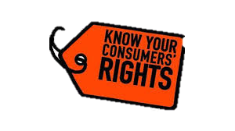
Domain | Identified practices | Related dark patterns
Consumer & competition cases | Obstructive refusal | Obstruction
 | Urgency claims | Urgency
 | Forced practices | Forced registration
 | Hidden costs and hidden information | Sneaking (Hidden costs)
 | - | -
Enforcement Summary
Enforcement Summary
Notes:
Regarding consumer and competition cases,
The majority of cases referred to darker DP
-mostly related to forced registration and sneaking, for example, companies charging optional extras without clearly disclosing them, not informing consumers of the commercial use of their data

Slide 6
Enforcement findings (a selection)
Cases do not refer to DP, but to infringements of principles or requirements that we related to DP practices. When rarely mentioned, DP are referred to in general, without qualifying each practice into a concrete granular type of dark pattern
DP are used by big tech (GAFAM), and small and public organizations, regardless business model/organization type
Most decisions refer to visual UI, UX, and information-based practices
Ambiguous scope of harms caused by DP in Enforcement. Decisions do not report (yet) harms caused by online manipulation
Notes:
In doing so, case law misses granular dark patterns that may translate across domains. A recent example shows that a EU regulator, the Italian DPA, used the concept of dark patterns related to
certain consent practices for the first time in an decision
1 -We suggest enforcers name and publicize violations as DPatterns in decisions.This way, organizations can factor the risk of sanctions into their business calculations, and policymakers can be aware of the true extent of practices, companies using dark patterns . Naming DPs is now most important since the DSA/DMA codify dark patterns explicitly - -so it is a legal term
Let's look at the privacy related dark patterns we found in these decisions
But leveraging from our expertise in both consumer and data protection laws, and in dark patterns violations, we could relate that Dark patterns are recurrent in the analysed cases
DProt law triggers legal protection against DP through overarching principles (fairness, transparency, data protection of data by default and by design, etc) and consent legal requirements that are not specific to dark patterns and regard individual harms of affected data subjects.
Let's look at the dark patterns we found in these decisions
Decisions analyse several practices that are related to dark patterns,
but without qualifying each practice into a concrete granular type of dark pattern. Current case law descriptions of
the use of dark patterns often report infringements only at a general level, but without qualifying each practice as a
concrete type of dark pattern [47 ].
the majority of decisions refer to visible dark patterns, which means that they refer to the User interface (UI) and user experience (UX) design practices that are easily identifiable from a regulatory and auditing perspective
our analysis did not reveal a high prevalence of the darkest dark patterns, because its detection remains a challenge for regulators, even if these patterns have the potential to impact negatively a large number of users, yet their manipulative effects might not always be immediately apparent.
Our findings suggest that current enforcement decisions may not adequately address the problem of unobtrusive, hidden-from-view practices.
Our case analysis revealed that decisions related with dark patterns exist, as far back as 2019, both from GDPR and consumer law decisions

Slide 7

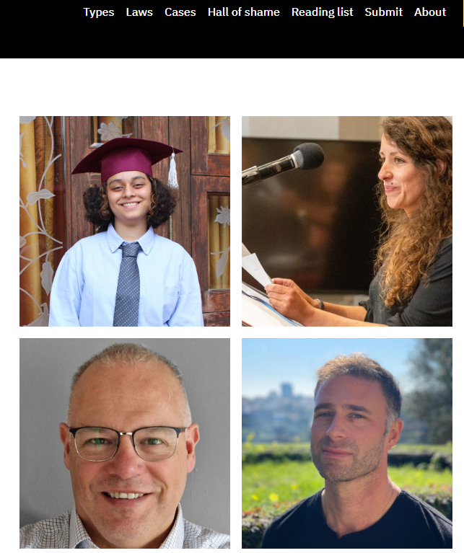
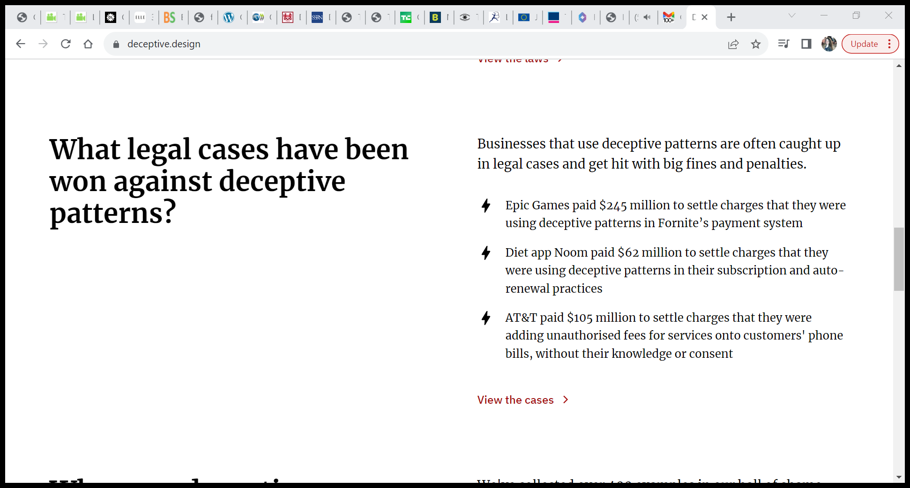
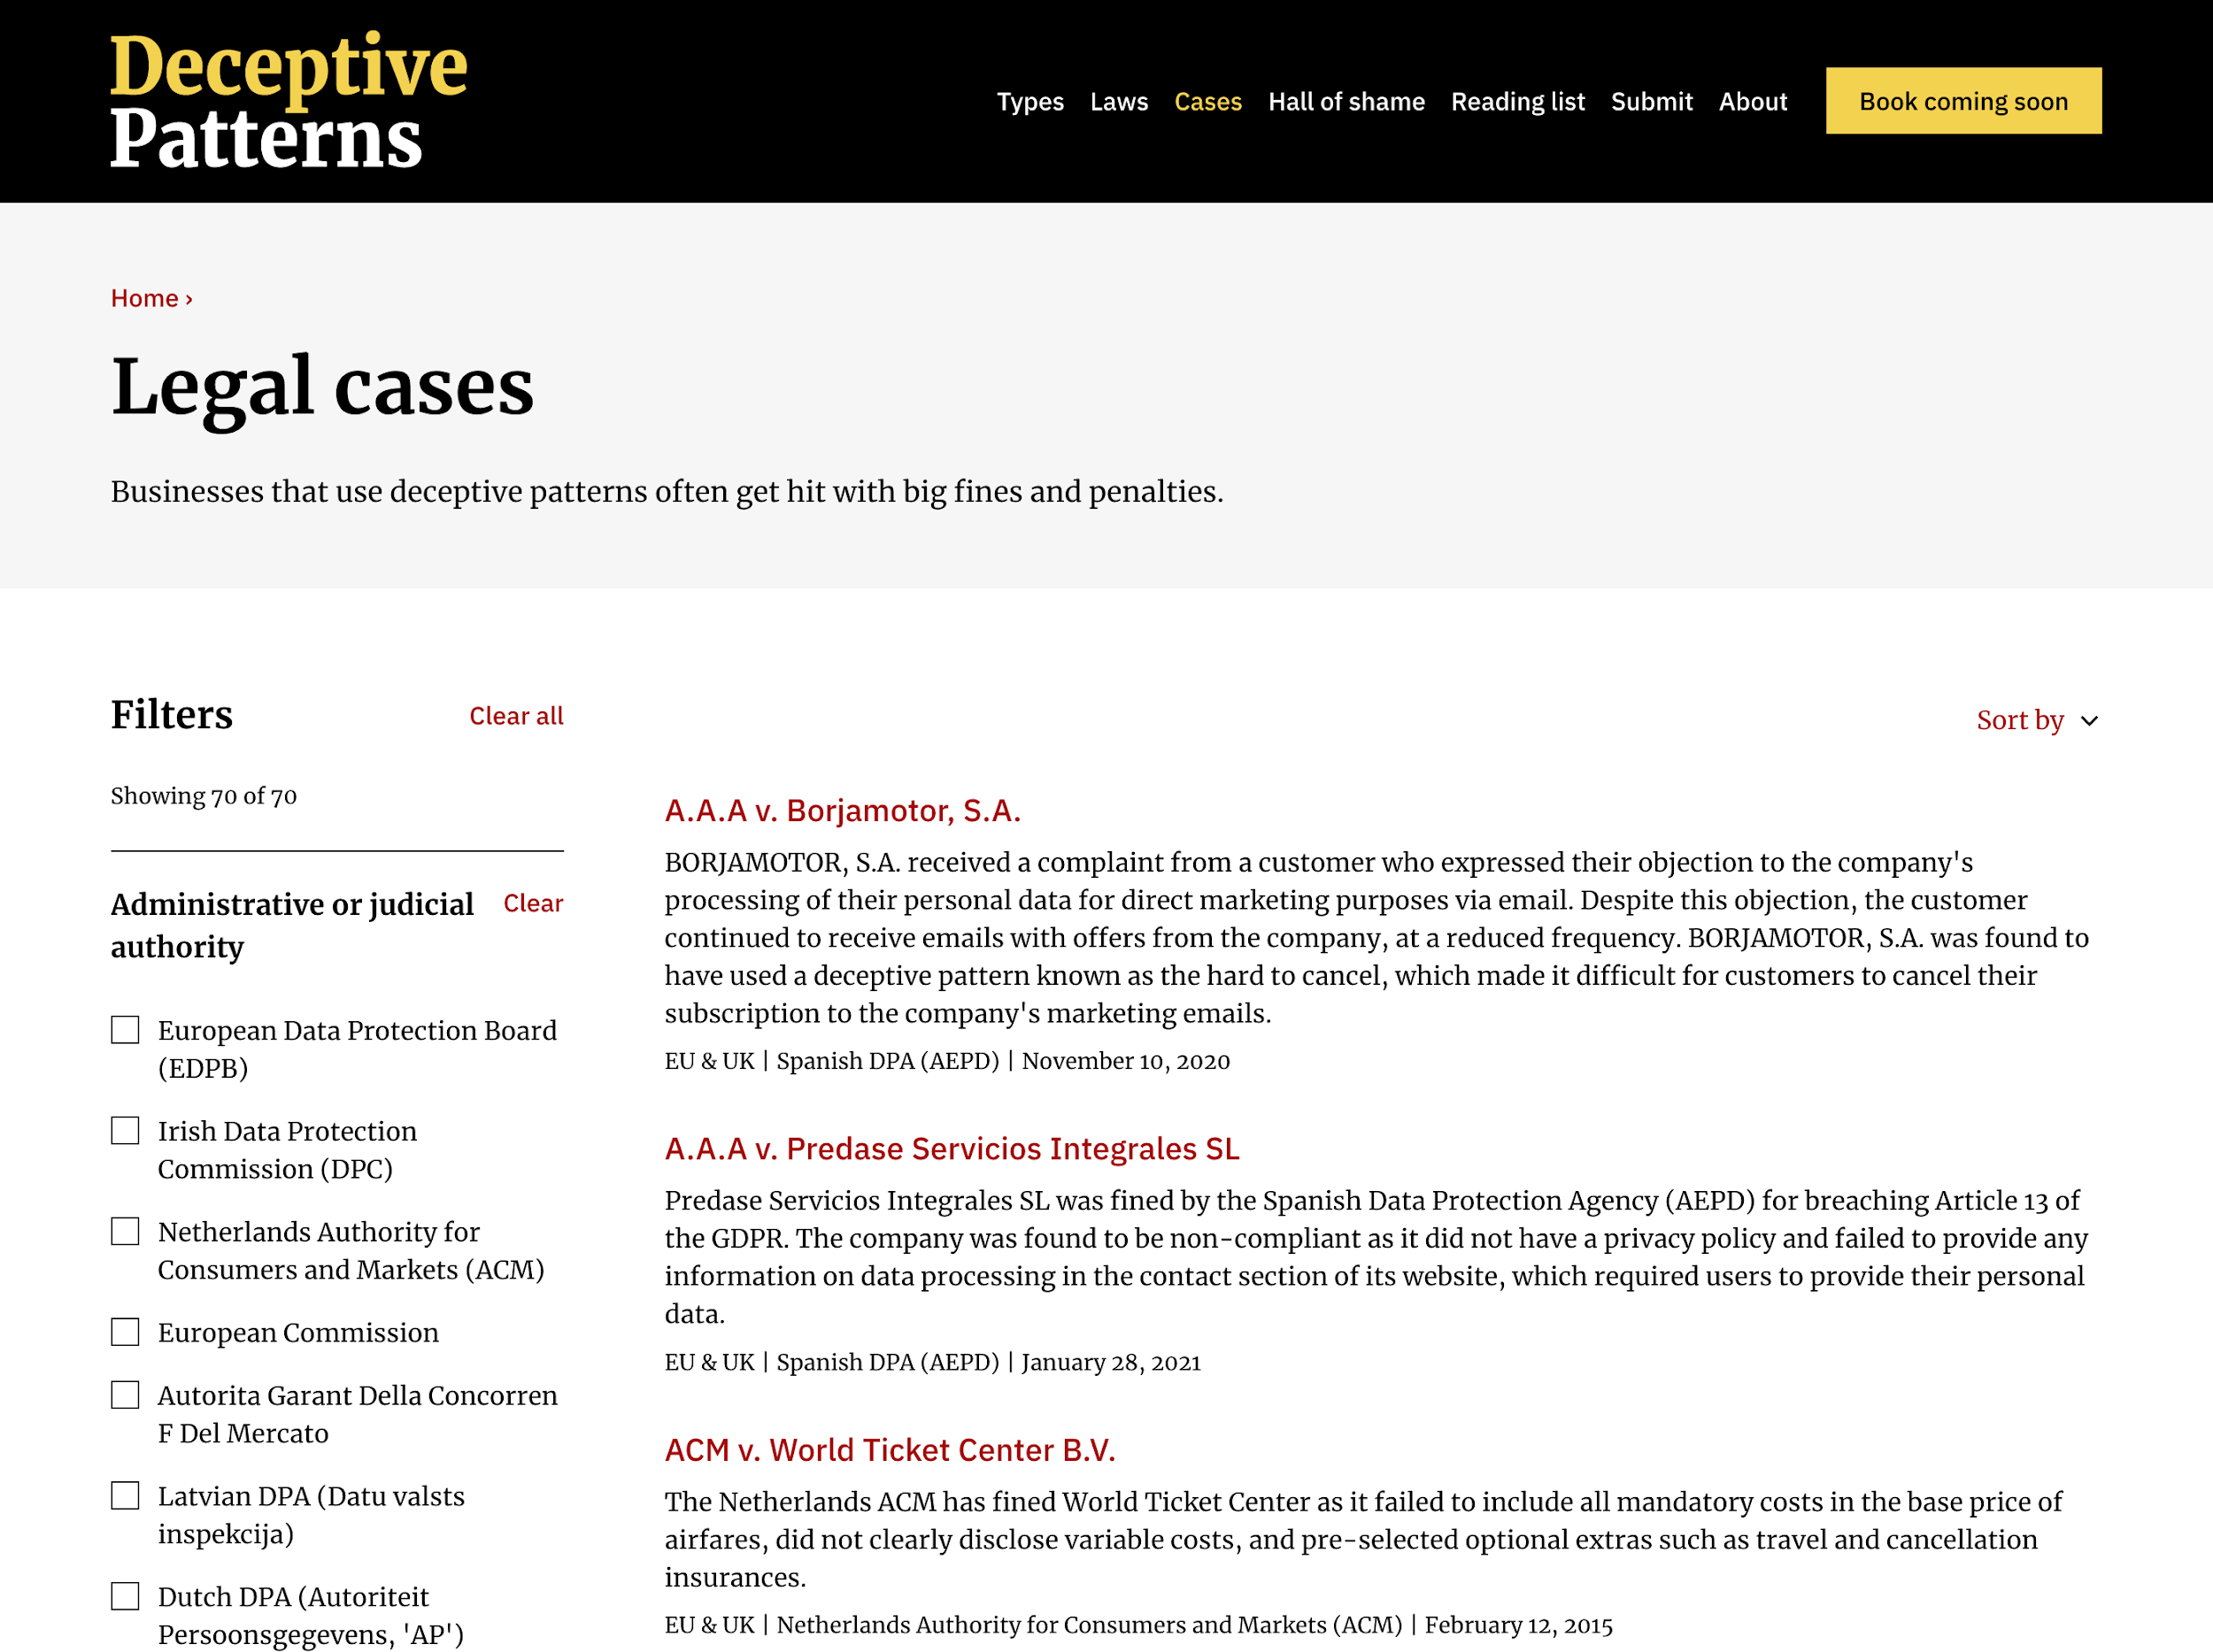
https://www.deceptive.design/cases
More than 100 cases analysed!
Notes:
We understand that enforcement cases are a way for general deterrence of dark patterns
we showcase these DP decisions in this website deceptive design updated daily with new decicions
-Cases do not refer to DP, but to infringements of principles/requirements that we related to DP practices.
-When rarely mentioned, DP are referred to in general, without qualifying each practice into a concrete granular type of dark pattern
-GAFAM, small,pub
-UI.UX, textural

Slide 8
Types of regulation for dark patterns
Regulation by enforcement (GDPR, UCPD)
  Decisions: most of them on consent
Regulation by binding law
  New laws prohibit dark patterns
Regulation through soft law
  DPA guidelines for consent
Regulation by technical tools
  consent automatisation

Slide 9

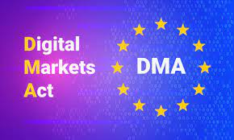
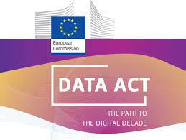

Will the new laws regulate dark patterns effectively?
Notes:
Legislation - a lot of hope about DMA and DSA:

Slide 10
News laws regulate dark patterns!
Laws | Article | Recital
DSA | A25: prohibits online platforms to design, organise or operate their online interfaces in a way that -deceives or manipulates recipients of a service or -materially distorts or impairs their ability to make free autonomous and informed decisions” | R67: “structure”, “design” “functionalities” of the U
DMA | A13 (6): by subverting end users’ or business users' autonomy, decision-making, or free choice via the structure, design, function or manner of operation of a user interface | R37: structure, design, function or manner of operation
Data Act proposal | A6(2)(a): “coerce, deceive or manipulate the user in any way, by subverting or impairing the autonomy, decision-making or choices of the user, including by means of a digital interface with the user” | R34: manipulative techniques can be used to persuade users, particularly vulnerable consumers, to engage in unwanted behaviours, and to deceive users by nudgingthem into decision on data disclosure
AI Act | A5(1)(a)(b): prohibits AI systems that - employ subliminal techniques ‘’in order to’’ materially distort a person’s behaviour; - exploit the vulnerabilities of specific groups (age, physical or mental disability) , in order to materially distort the behaviour and cause harm | R16: intention to materially distort the behaviour of a person and in a manner that causes or is likely to cause (e.g., psychological) harm to that or another person
Notes:
all 4 new legislations include legal provisions on CH. legal provisions specifically that targeting DPs and harm is included!
Forthcoming legislation refers to specific prohibitions and acknowledges different influence types but does not define it
Though the DSA refers to the UI of digital systems, such provision should be interpreted as encompassing practices that go beyond the UI
DSA: focus on GUI, less focus on surface-free interactions and their potential for manipulative design practices.
the placing on the market, putting into service or use of an
AI system that deploys subliminal techniques beyond a person’s
consciousness in order to materially distort a person’s
behaviour in a manner that causes or is likely to cause that
person or another person physical or psychological harm;

Slide 11
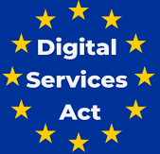
Dark Patterns in the DSA
Text of Article 25(3) and Recital 67 | Ontology of DPs
1- Giving more prominence to certain choices […] for a decision” - Presenting choices in a non-neutral manner, such as giving more prominence to certain choices through visual, auditory, or other components, when asking the recipient of the service for a decision. (A 25(3), R67) | Visual Prominence, False Hierarchy
2-Repeatedly requesting a recipient of the service to make a choice where such a choice has already been made” (A 25(3), R 67) | Nagging
3-Making certain choices (the procedure for terminating a service/signing out/discontinue purchases) more difficult than subscribing to it (A 25(3), R 67) | Obstruction (Roach Motel, Creating Barriers, Adding Steps)
4 - Deceiving the recipients of the service by nudging them into decisions on transactions (R67) | Sneaking
5- Deceiving the recipients of the service by default settings that are very difficult to change, and so unreasonably bias the decision making of the recipient of the service, in a way that distorts and impairs their autonomy, decision-making and choice (R 67) | Bad Defaults
Gray, Santos, Bielova, Mildner. 2024. An Ontology of Dark Patterns Knowledge: Foundations, Definitions, and a Pathway for Shared Knowledge-Building. CHI’24 https://doi.org/10.1145/3613904.3642436

Slide 12


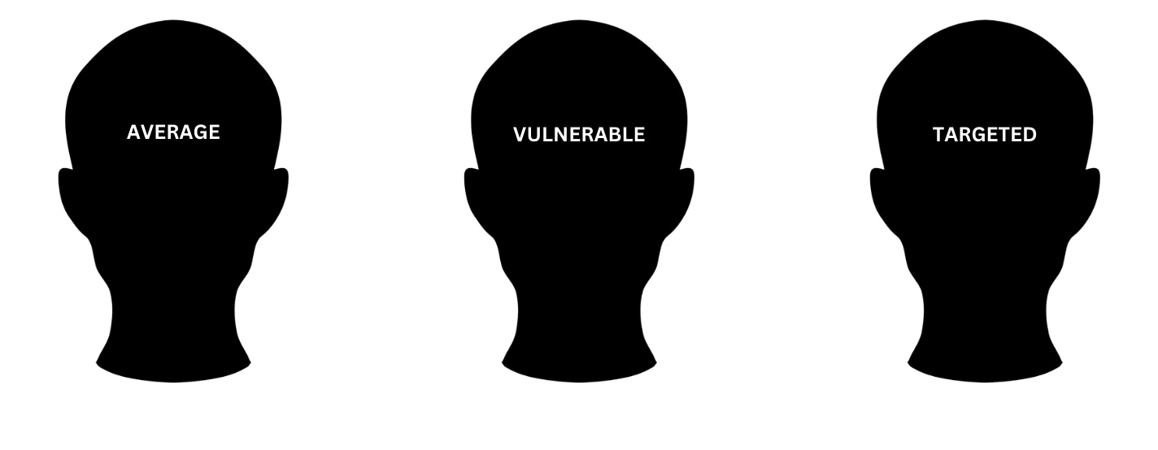
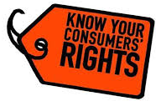
Unclear provision of Article 25 of the DSA
Manipulation not defined; how to differentiate several influence-types? = manipulate, deceive, distort, impairs, persuade, nudge, or unreasonably bias => lead to different interpretations
Is manipulation actual or potential?
(proof of deception vs practice likely to have effect)
What is the benchmark of protection of a recipient of a service?
DSA excludes practices scoped under the UCPD, but what are the boundaries between UCPD and DSA?
Notes:
undefined space surrounding them might lead to different interpretations for platforms, designers, developers, regulators, and policymakers to foreground and disambiguate, each according to their own pursuits.
Article 25 does not specify what is the suitable benchmark of a recipient of a service (‘’average’’ or ‘’vulnerable’’ users). Such a benchmark is useful to delineate the scope of protection used to determine whether a dark pattern is likely to deceive users. While the DSA explicitly refers to the term "average user" for consumers (Recital 24), it lacks explicit clarity concerning its application to business users. In the context of online advertising referred to in Recital 68, the term ‘average recipient of the service’ is used, though such comparison needs to be contextualized considering sophisticated use of technologies and interface design in digital services that all users are exposed to and often have difficulties with making free, informed and autonomous choices or decisions

Slide 13
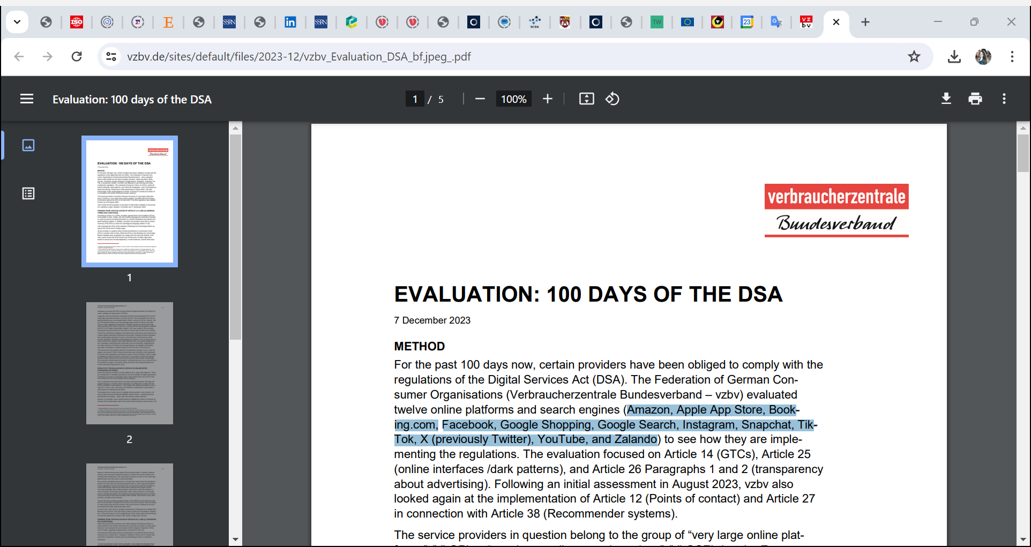
VZBV audited platforms under Article 25
Fed. German Cons. Org. audited 12 online platform practices under the DSA
Amazon, Booking.com, Google Shopping, YouTube do not comply with DP ban
  Highlighted buttons related to paid subscriptions
  more difficult to end a service or delete an account than to register for a service or set up an account
  nagging
  default settings…
How the practices differ from the ones already covered by UCPD?
https://www.vzbv.de/en/100-days-digital-services-act-consumer-protection-online-platforms-still-insufficient
Notes:
(Verbraucherzentrale Bundesverband e.V. – vzbv)
Question: how the dark patterns your audit identified differ from the practices already covered by UCPD?
Is it because the UCPD ‘s provisions would have to be equally or more specific to take precedence in relation to dark patterns?
vzbv carried out the evaluation on the basis of information available on the providers’ websites or apps between 12 October and 17 November 2023.

Slide 14
Types of regulation for dark patterns
Regulation by enforcement (GDPR, UCPD)
  Decisions: most of them on consent
Regulation by binding law
  New laws prohibit dark patterns
Regulation through soft law
  DPA guidelines for consent
Regulation by technical tools
  consent automatisation

Slide 15

Are DPA guidelines effective to regulate dark patterns?

Slide 16
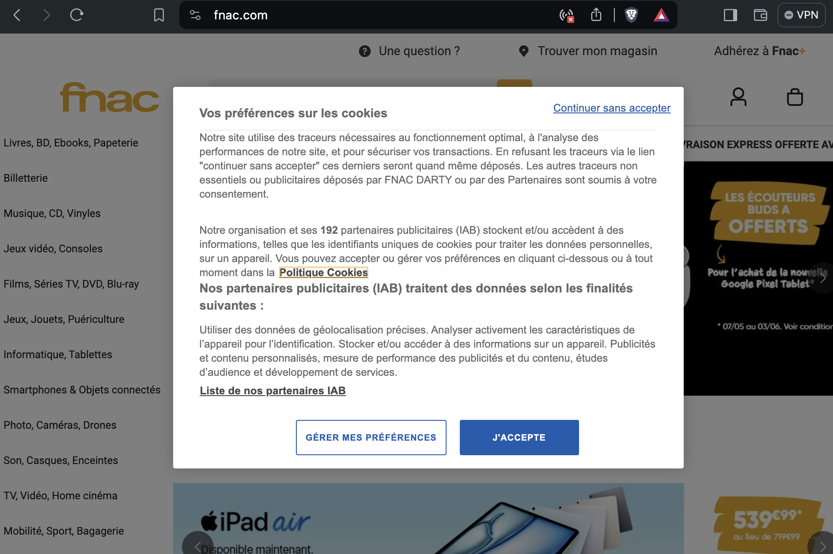
Let’s take one website

Slide 17
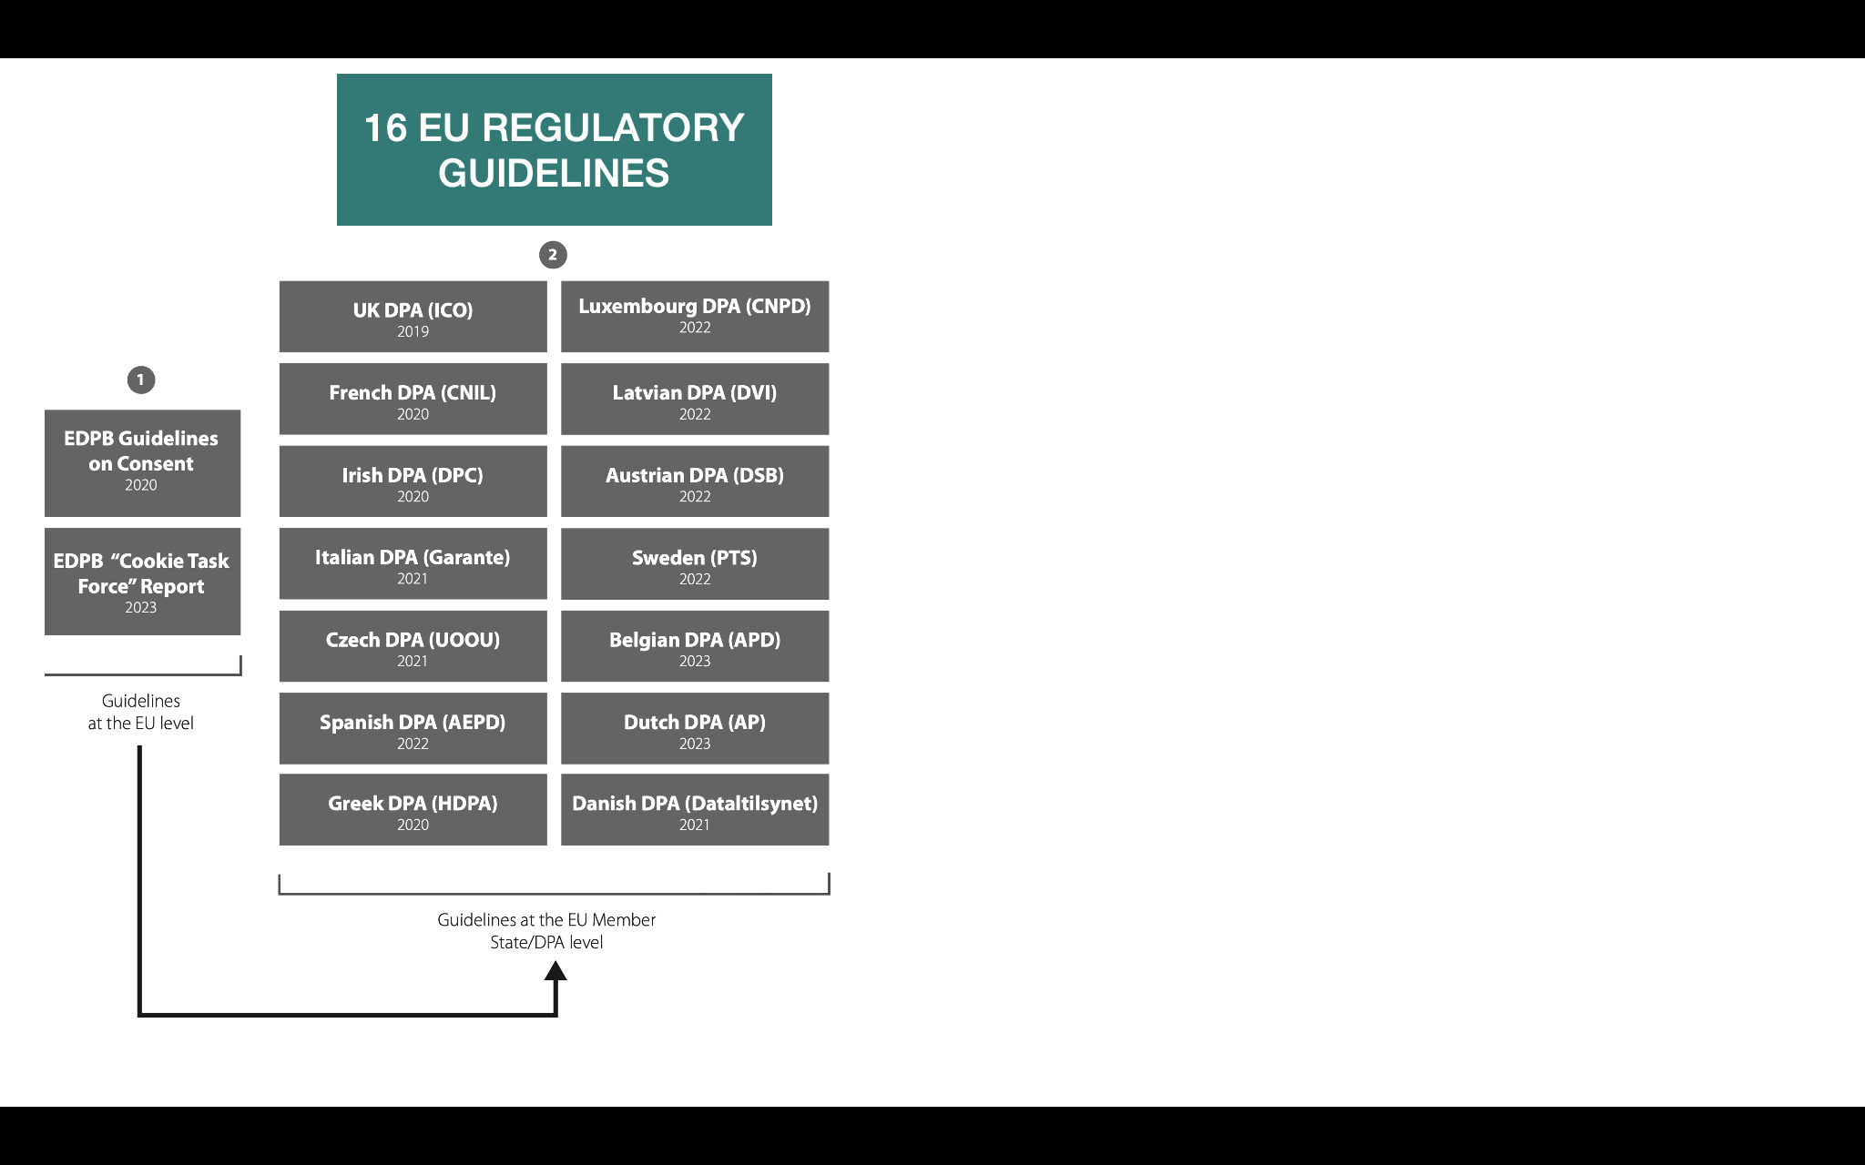
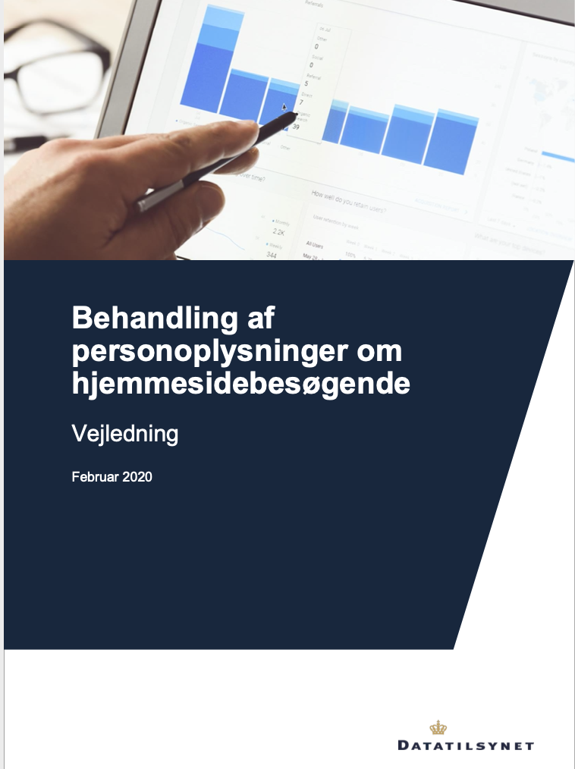
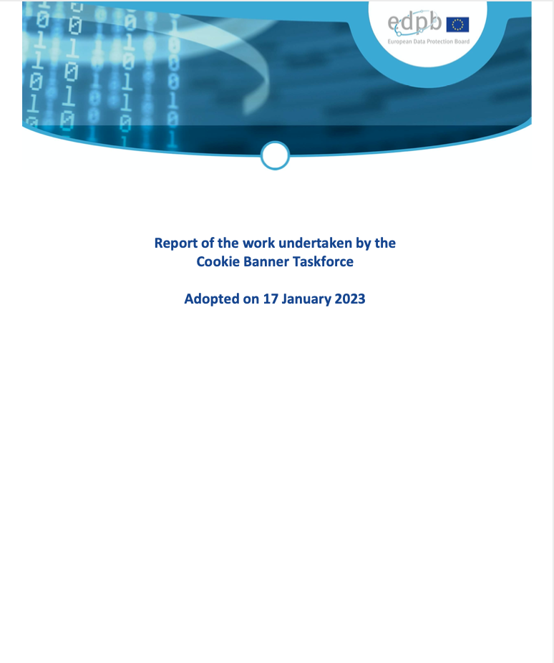
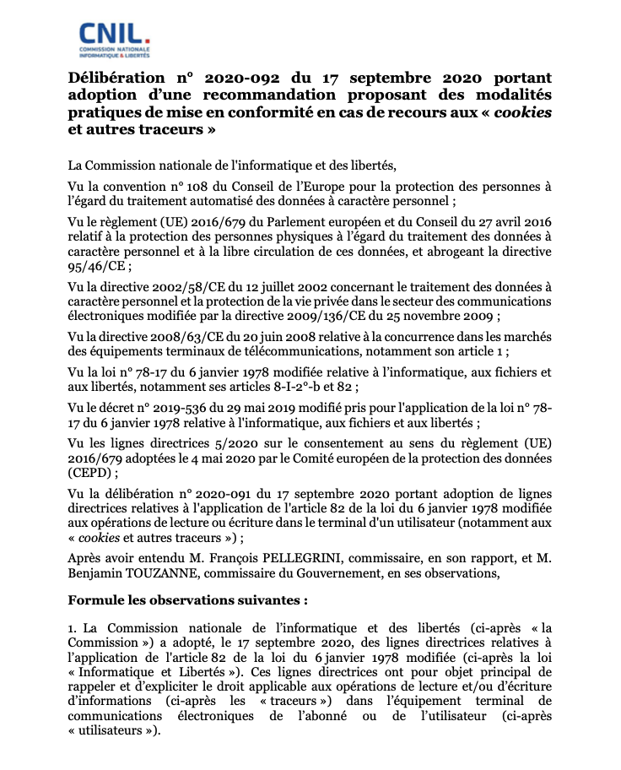
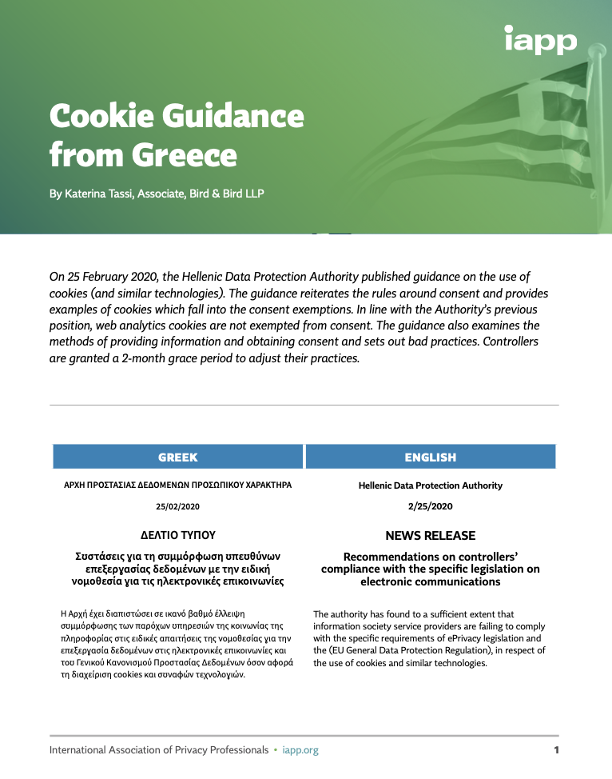
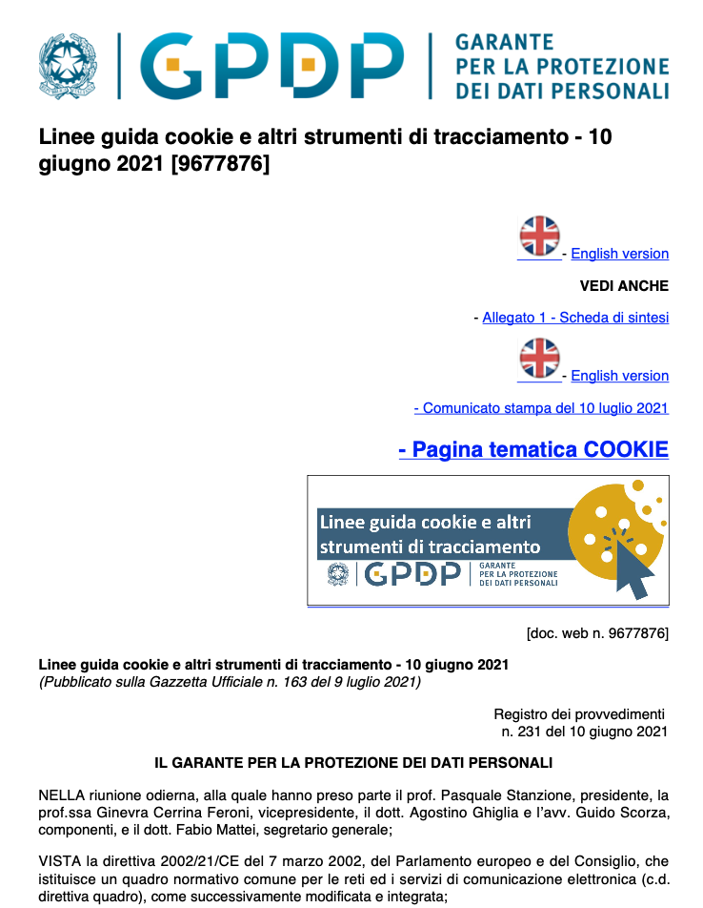
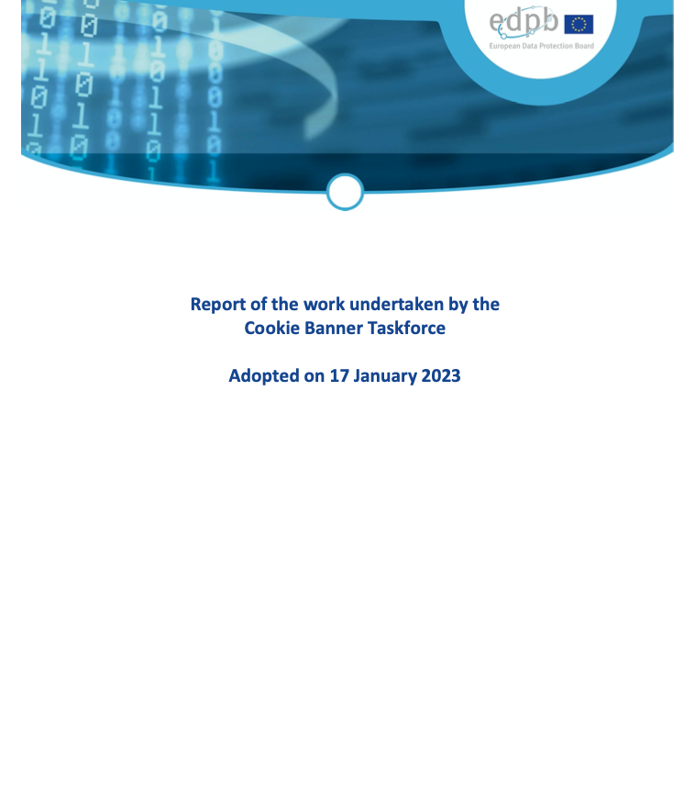
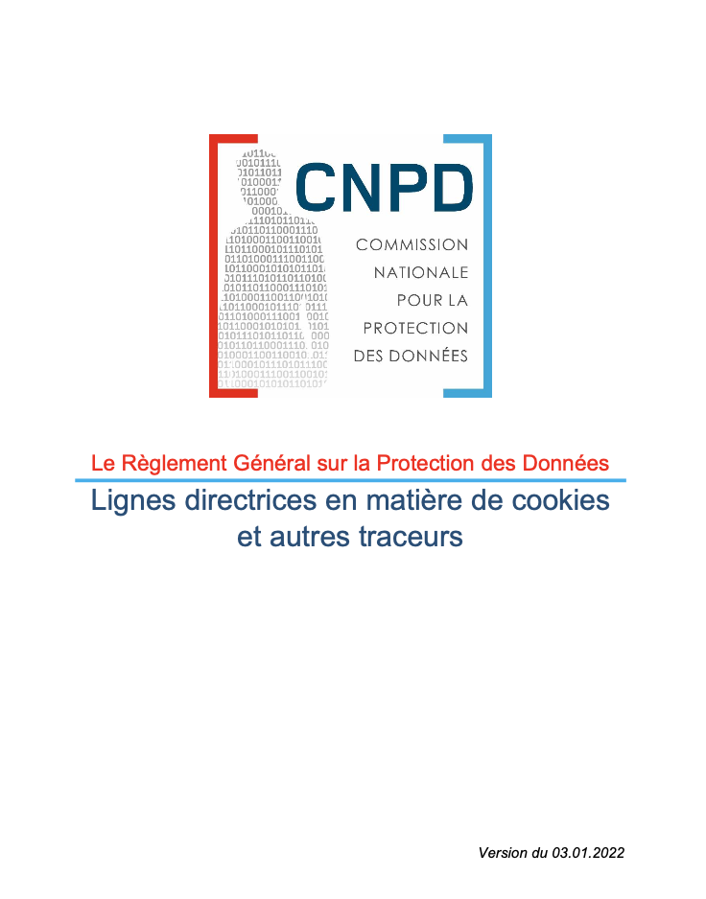

Slide 18
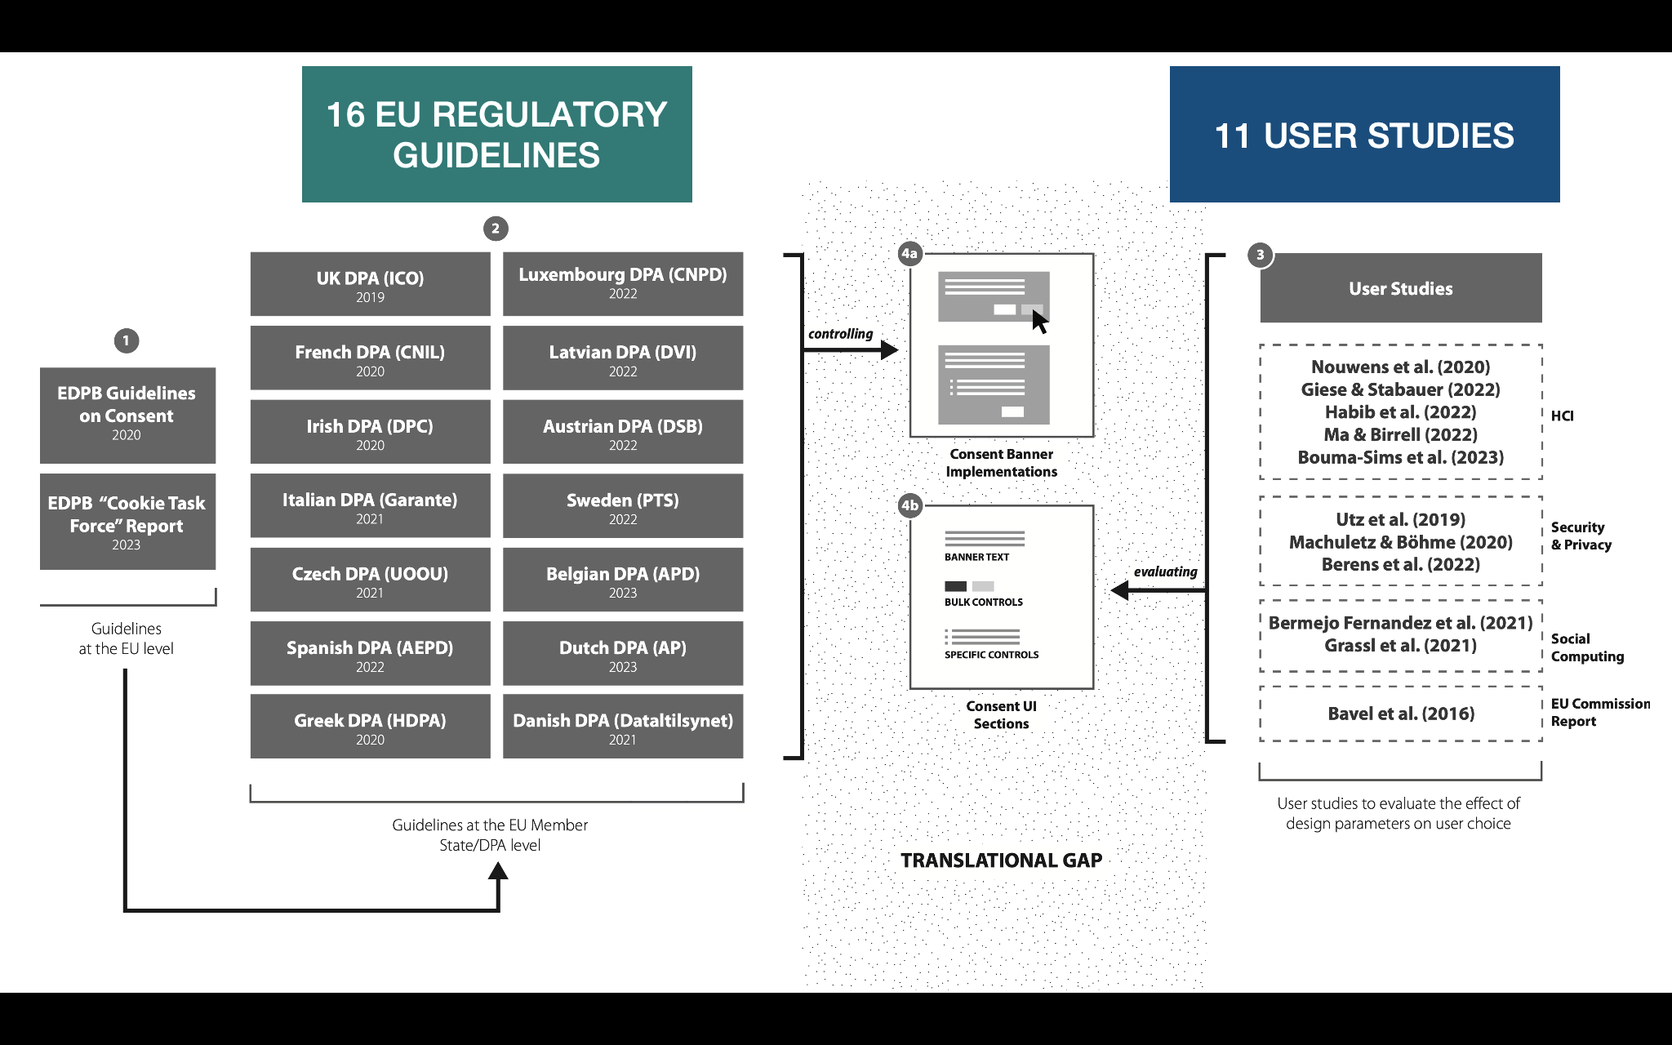
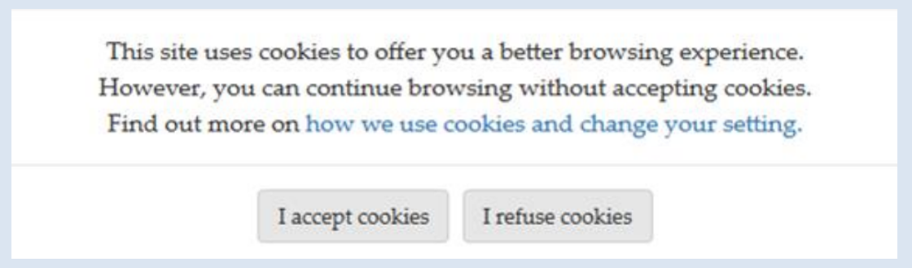
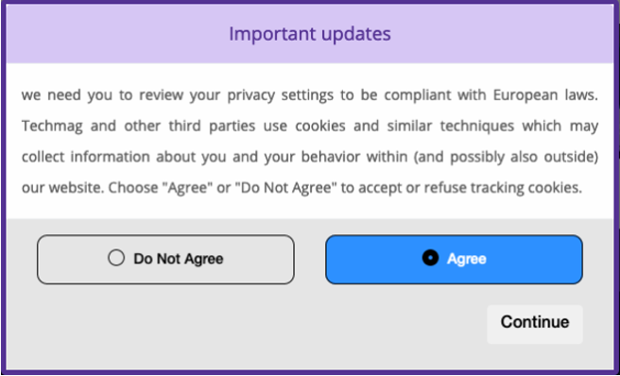
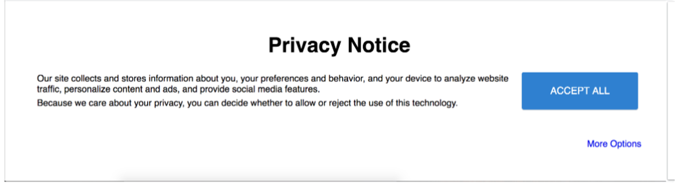
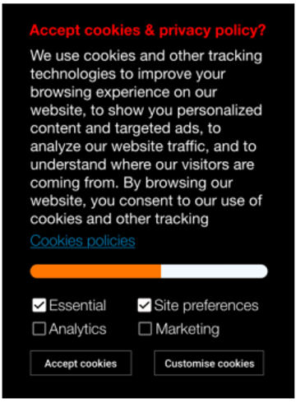
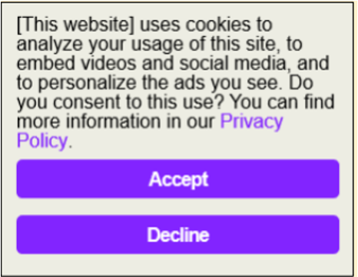
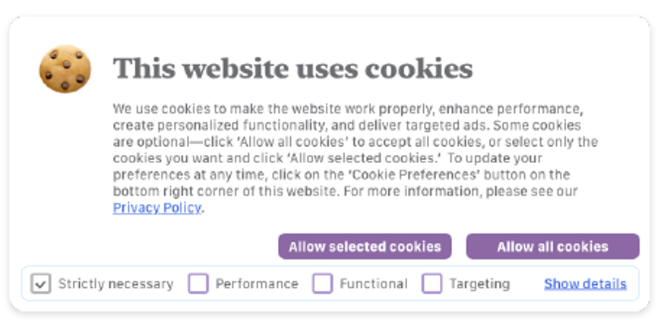
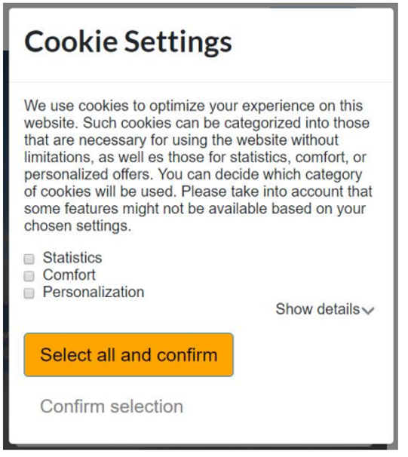
Notes:
Academic researchers at the same time, started analysing manipulative UX tactics, commonly known as dark patterns, in consent banners and quantifying how much one change in a design parameter can impact the decision-making of the users.
[CLICK] In our extensive analysis of the academic literature, we identified 11 consent-focused user studies that provide empirical evidence on how design choices and dark patterns substantially influence users’ consent decisions. Such studies were performed in HCI, Security and Privacy, and Social Computing fields, and also by the EU Commission.
Moreover, these studies were done with users from various countries, including the US, UK, Spain and Germany.

Slide 19



Slide 20
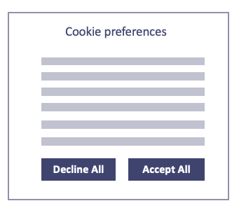
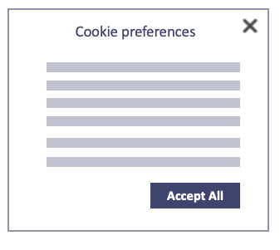
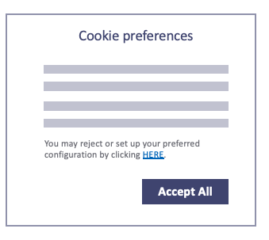
GAP AMONG REGULATORS
WHICH CONSENT BANNER IS COMPLIANT?
Accept and decline
on the first layer
French, Spanish, Luxembourg, Irish, Dutch, UK, Denmark, Greek, Latvian, Czech, Austrian and Finnish DPAs
Closing the banner means no consent is given
Italian, Latvian DPAs
“at least provide information that allows the user to reject non-necessary cookies“
Irish DPAs

Slide 21
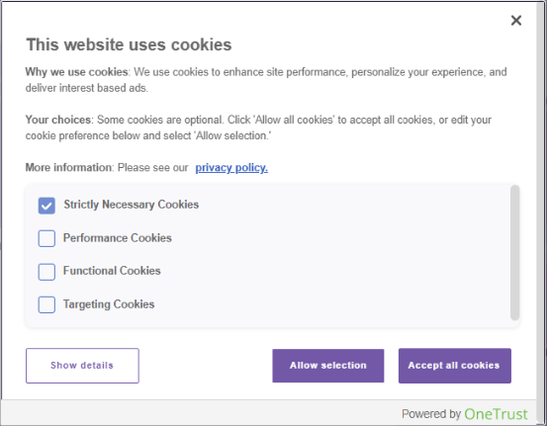
GAP BETWEEN DPA GUIDELINES AND USER STUDIES
GAP: “CROSS-SIGN” IS CONFUSING FOR THE USERS
Closing the banner means no consent is given
Italian, Latvian DPAs
Participants were confused about what would occur if they clicked cross-sign “X”:
24.0% expected to receive no cookies,
17.2% expected the website to set some or all cookies
Bouma-Sims et al. 2023
Notes:
Additionally to gaps, we have identified 5 insights for researchers. These insights show areas of disagreement among regulators or lack of user studies, where further research is needed. We believe these insights will guide usable privacy and HCI community to evaluate such unexplored design parameters.
For example, we have found out that for specific control, several regulators support the idea of giving user a choice per purpose. The Luxembourg DPA proposes a specific design with one “submit” button, like shown here. While some user studies found that adding a bulk “accept all” highlighted button nudges users towards acceptance of all purposes, other studies still include this button in their banner interfaces, thus nudging users.
Therefore, more research is needed to compare users understanding and decisions of designs with only one submit button versus other types of recommended designs.

Slide 22
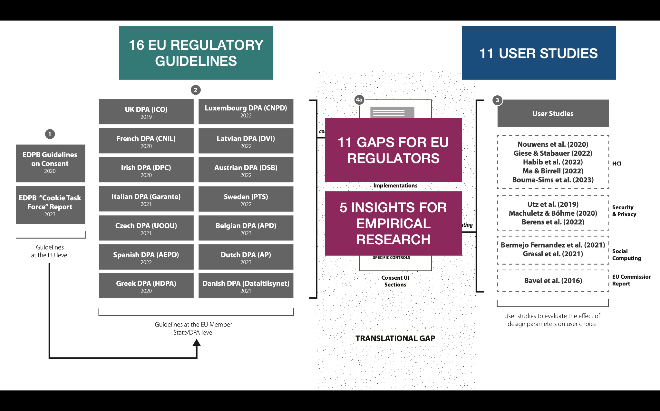

Slide 23
Types of regulation for dark patterns
Regulation by enforcement (GDPR, UCPD)
  Decisions: most of them on consent
Regulation by binding law
  New laws prohibit dark patterns
Regulation through soft law
  DPA guidelines for consent
Regulation by technical tools
  consent automatisation

Slide 24
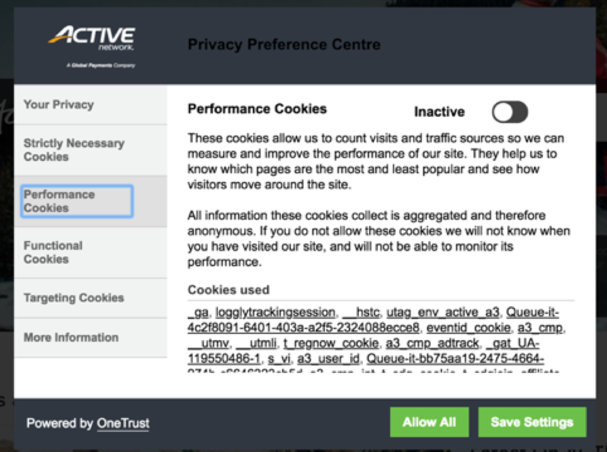
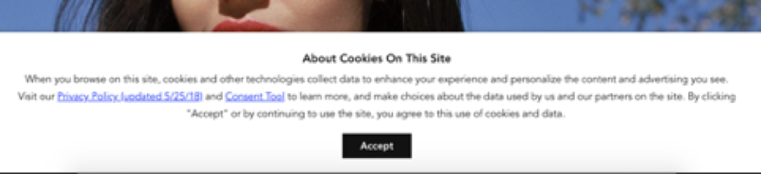
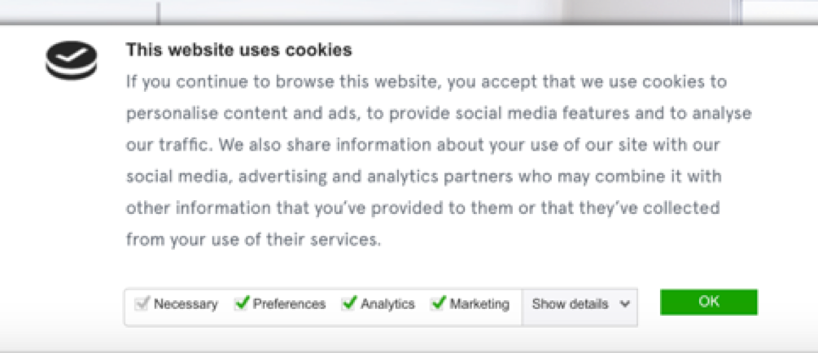
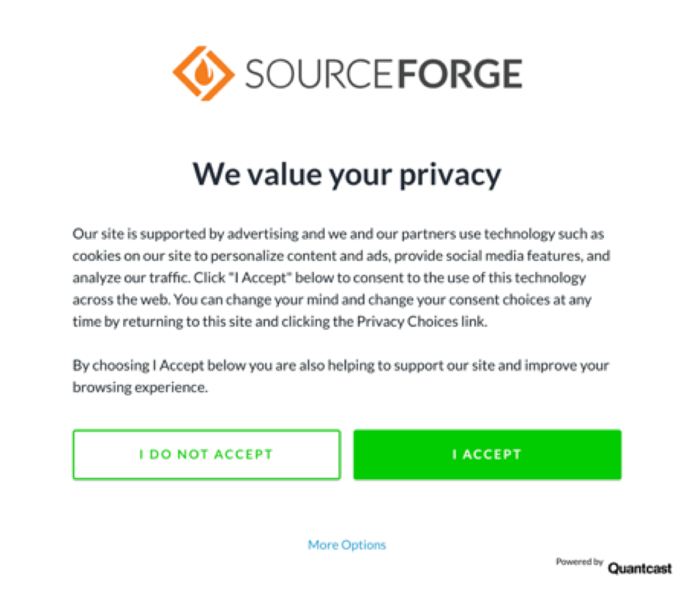
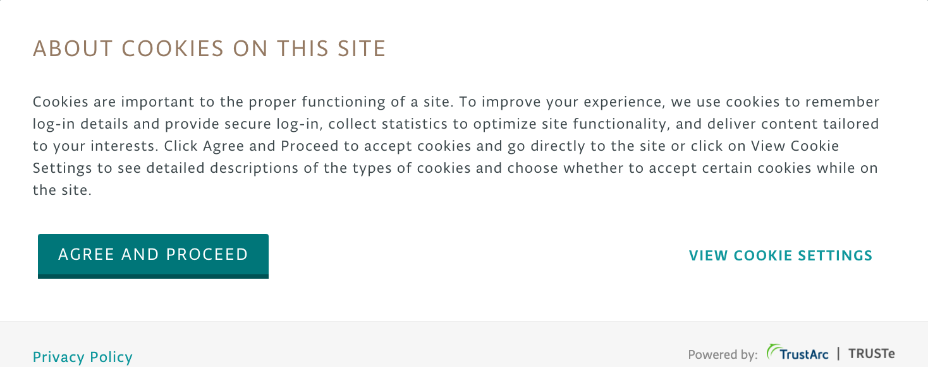
What are Consent Management Platforms?
OneTrust
CrownPeak
CookieBot
Quantcast
TrustArc

Slide 25
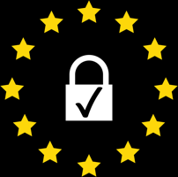
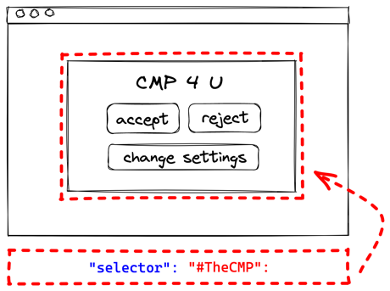
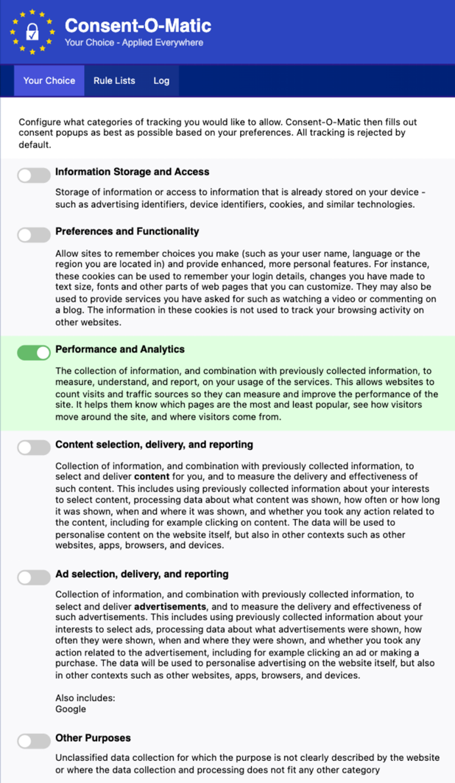
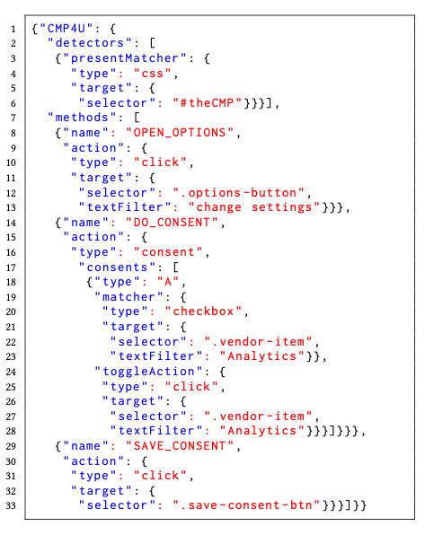
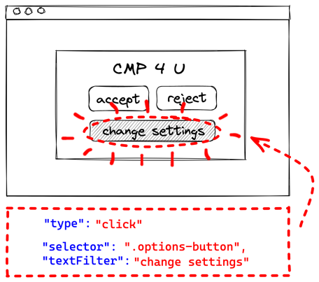
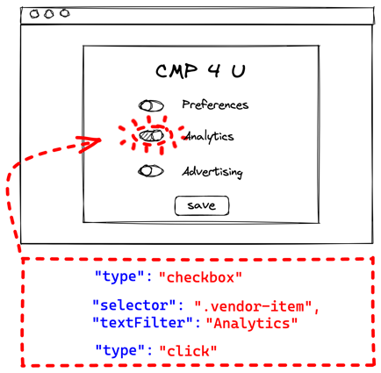
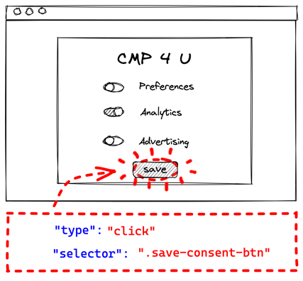
consent-o-matic: consent automation
identify
~70.000 users
click
available on:
toggle
consentomatic.au.dk
save
Site courtesy of Midas Nouwens
user preferences
JSON ruleset
25

Slide 26
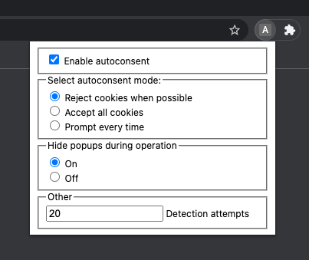
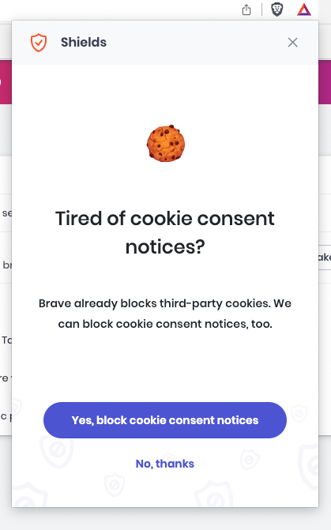
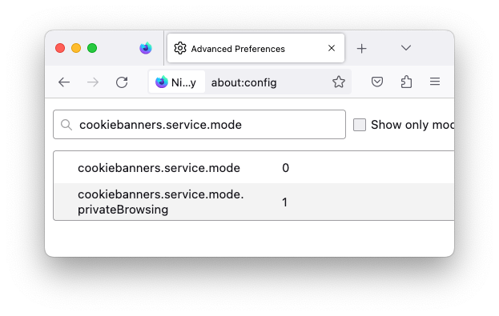
Browsers provide consent automation too!
0: Reject all (default)
1: Accept all
2: Prompt
0: Accept all (default)
1: Reject all, or prompt
2: Reject all, or accept all
Prevents pop-up from loading
Blocks urls using 23670 keywords
Site courtesy of Midas Nouwens

Slide 27
Conclusions
Regulation by enforcement (GDPR, UCPD): dark patterns should be named in decisions
Regulation by binding law: DSA came in force but companies still don’t comply, laws without enforcement are not enough
Regulation through soft law: guidelines should be informed by academic results: studies identifying dark patterns and experiments with users
Regulation by technical tools: more effective but…
  Are Consent Management Providers allowed to block automation?
Would regulators support standardisation as effective regulation?
  EDPB Task Force (2023): “general banner standard concerning colour and/or contrast cannot be imposed on data controllers”
  CNIL recommendation (2020): “encourages the development of standardized interfaces, operating in the same way and using a uniform vocabulary”

